Slide 1
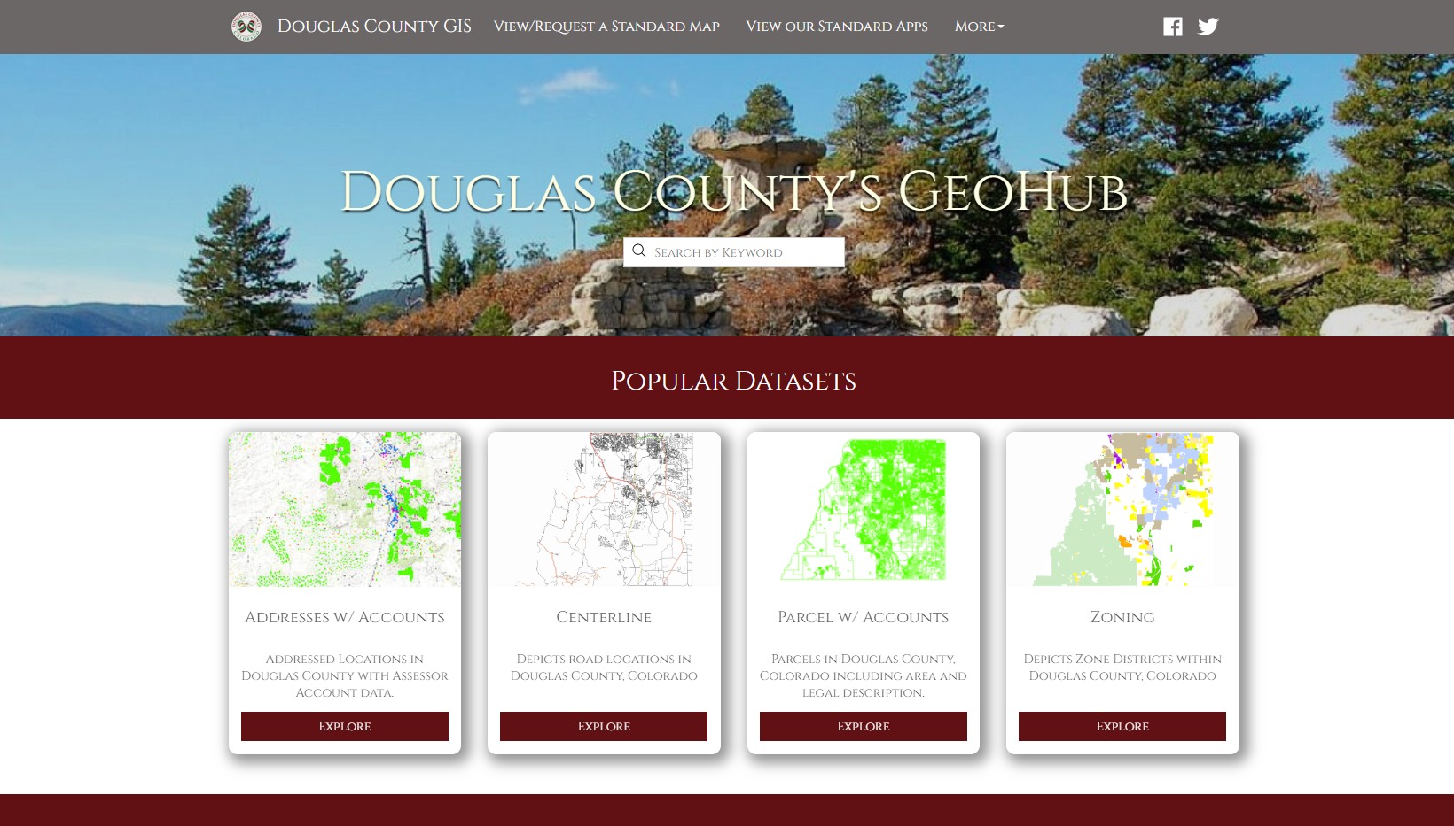

Slide 2
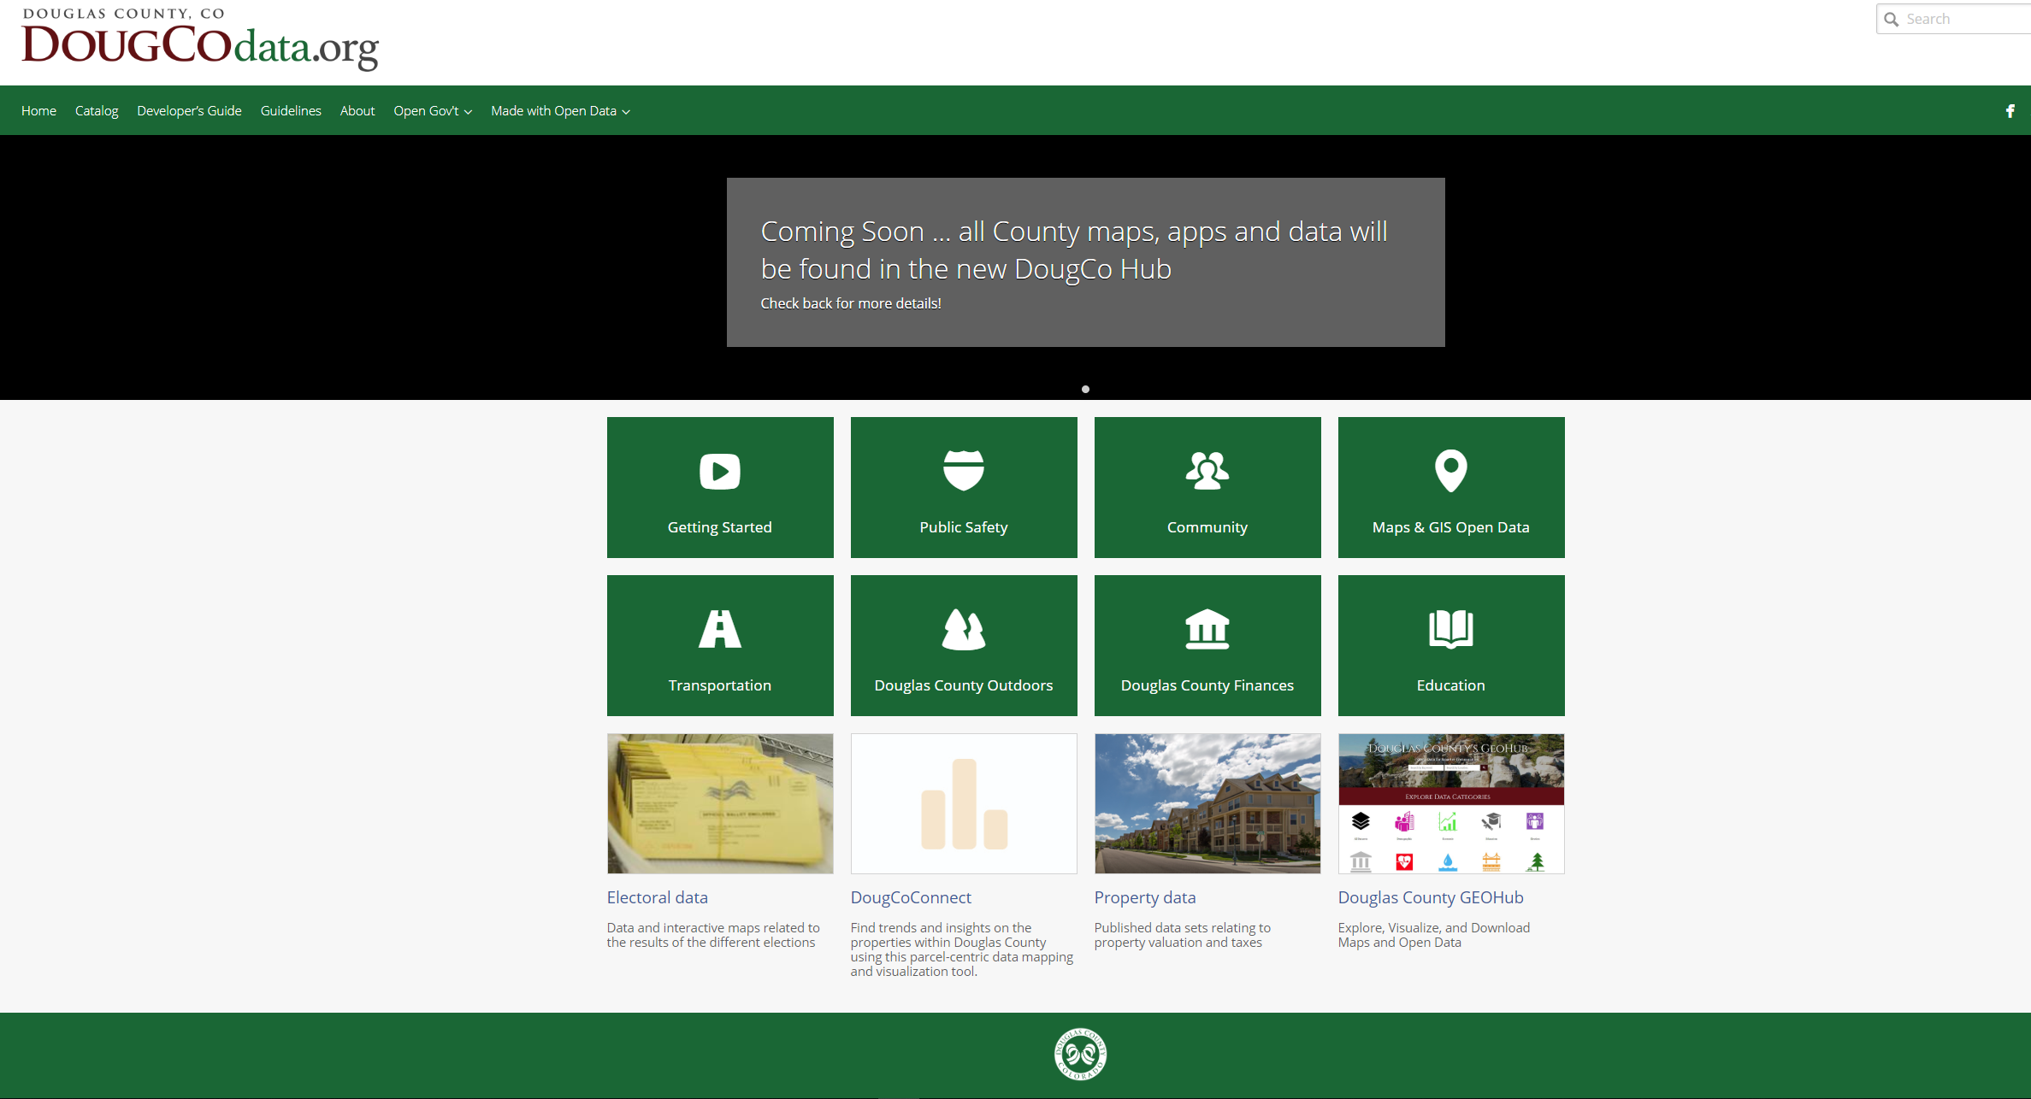

Slide 3
Douglas County’s GeoHub
(ESRI)
DougCoData.org
(Socrata)

Slide 4
GeoHub
Transportation Hub

Slide 5
GeoHub
Economic Foundations
Historic & Natural Resources
Health & Human Services
Transportation Hub
Public Safety
County Services

Slide 6
DougCo
Hub
GeoHub
Economic Foundations
Historic & Natural Resources
Health & Human Services
Transportation Hub
Public Safety
County Services
DougCoData.org
(Socrata)

Slide 7
DougCo
Hub
GeoHub
Economic Foundations
Historic & Natural Resources
Health & Human Services
Transportation Hub
Public Safety
County Services

Slide 8
